Slide 1
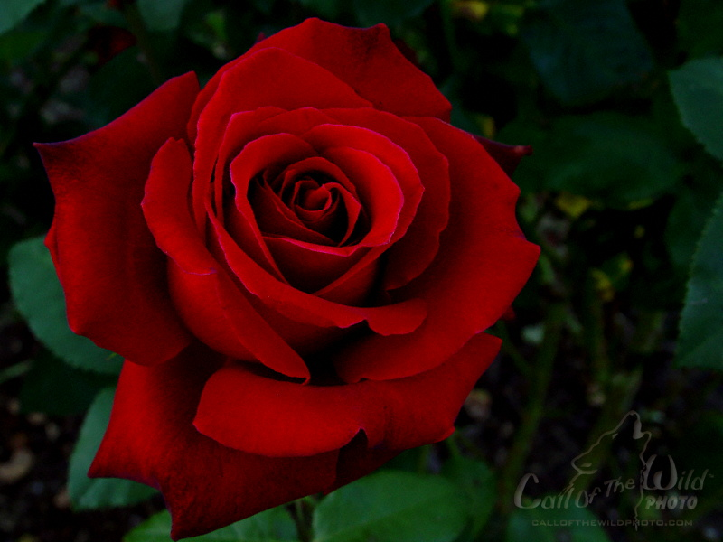
The Bachelorette starring Alisoun
Produced by:
Rebecca Miller, Molly Cantwell,
Brian Spain, Stephanie Pace

Slide 2

Contestant #1
Question 1: Tell me a little about yourself?

Slide 3
Contestant #2
Question 1: Tell me a little about yourself?

Slide 4
Contestant #3
Question 1: Tell me a little about yourself?

Slide 5
Contestant #1
Question 2: What’s the craziest thing you have done for a girl?

Slide 6
Contestant #2
Question 2: What’s the craziest thing you have done for a girl?

Slide 7
Contestant #3
Question 2: What’s the craziest thing you have done for a girl?

Slide 8
Contestant #1
Question 3: What ended your last relationship?

Slide 9
Contestant #2
Question 3: What ended your last relationship?

Slide 10
Contestant #3
Question 3: What ended your last relationship?

Slide 11
Contestant #1
Question 4: What do you look for in a girl?

Slide 12
Contestant #2
Question 4: What do you look for in a girl?

Slide 13
Contestant #3
Question 4: What do you look for in a girl?

Slide 14
Contestant #2
Question 5: What kind of date would you take me on?

Slide 15
Contestant #3
Question 5: What kind of date would you take me on?

Slide 16
And the winner is….

Slide 17
CONTESTANT #2!!

