Slide 1



Slide 2
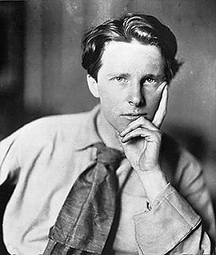
Rupert Brooke

Slide 3
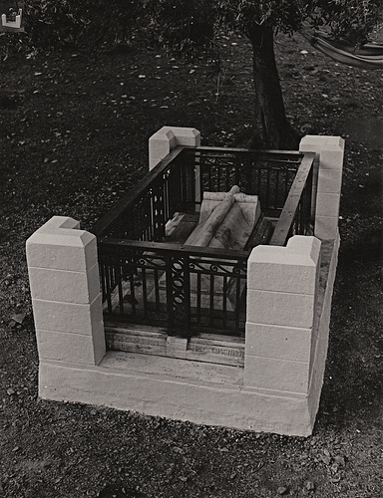
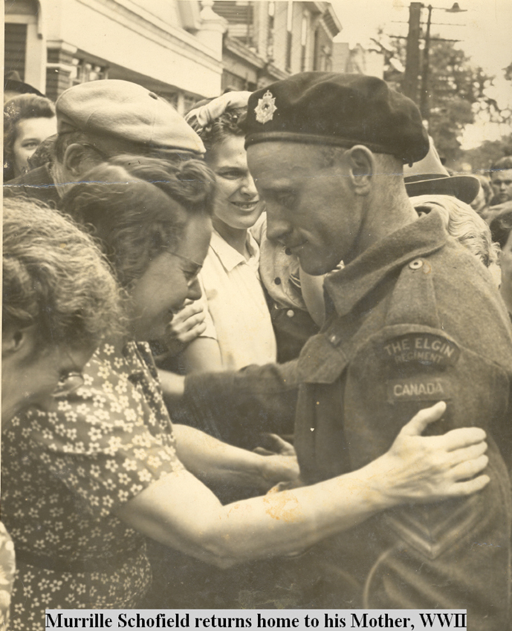
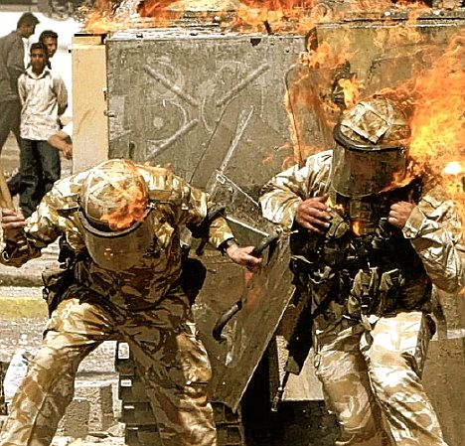
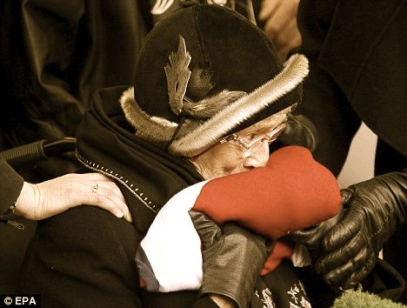
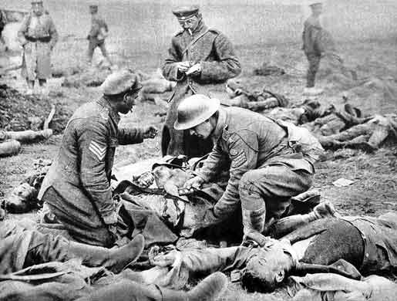
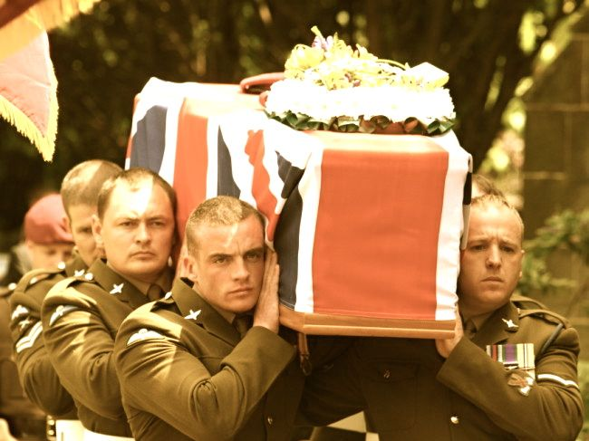

If I die young, bury me in satin
Lay me down on a, bed of roses
Sink me in the river, at dawn
Send me away with the words of a love song
Lord make me a rainbow
I'll shine down on my mother
She'll know I'm safe with you when she stands under my colors, oh and
Life ain't always what you think it ought to be, no
Ain't even grey, but she buries her baby
The sharp knife of a short life, well,
I've had just enough time
A penny for my thoughts, oh no,
I'll sell them for a dollar
They're worth so much more after I'm a goner
And maybe then you'll hear
the words I been singin’
'Funny when you're dead how people start listenin'

Slide 4
IF I DIE YOUNG
If I die young, bury me in satin
Lay me down on a, bed of roses
Sink me in the river, at dawn
Send me away with the words of a love song
Lord make me a rainbow
I'll shine down on my mother
She'll know I'm safe with you when she stands under my colors, oh and
Life ain't always what you think it ought to be, no
Ain't even grey, but she buries her baby
The sharp knife of a short life, well,
I've had just enough time
A penny for my thoughts, oh no,
I'll sell them for a dollar
They're worth so much more after I'm a goner
And maybe then you'll hear
the words I been singin’
'Funny when you're dead how people start listenin'
THE SOLDIER
If I should die, think only this of me:
That there's some corner of a foreign field
That is for ever England. There shall be
In that rich earth a richer dust concealed;
A dust whom England bore, shaped, made aware, Gave, once, her flowers to love, her ways to roam,
A body of England's, breathing English air,
Washed by the rivers, blest by suns of home.
And think, this heart, all evil shed away,
A pulse in the eternal mind, no less
Gives somewhere back the thoughts by England given;
Her sights and sounds; dreams happy as her day;
And laughter, learnt of friends; and gentleness,
In hearts at peace, under an English heaven.

Slide 5
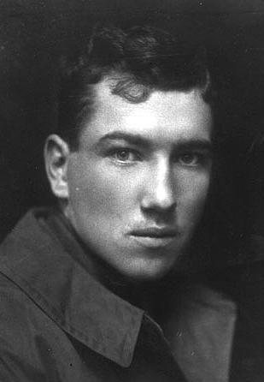
Robert Graves

Slide 6
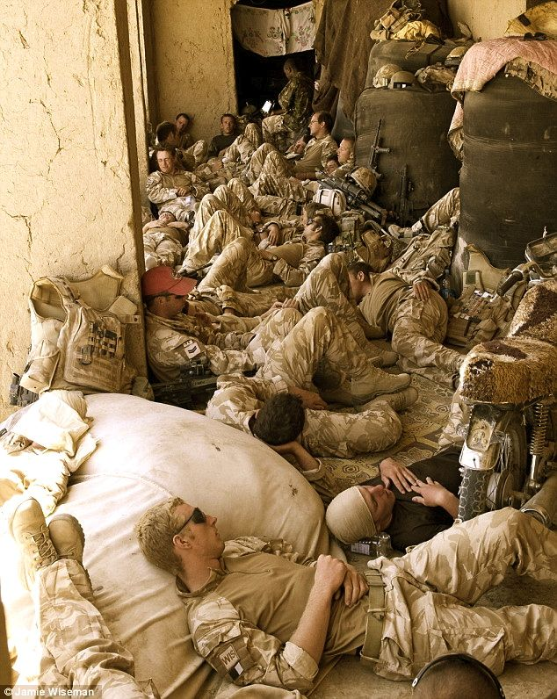
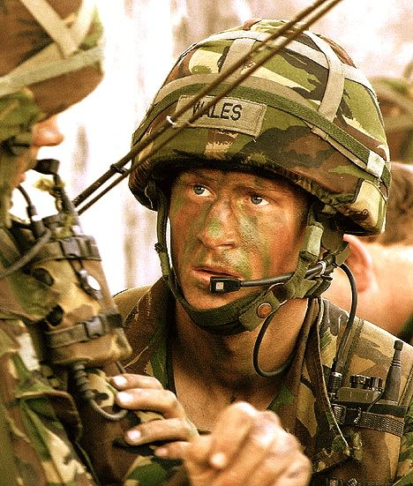
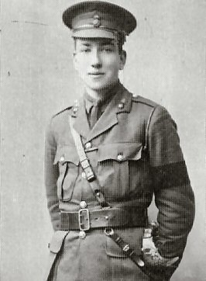

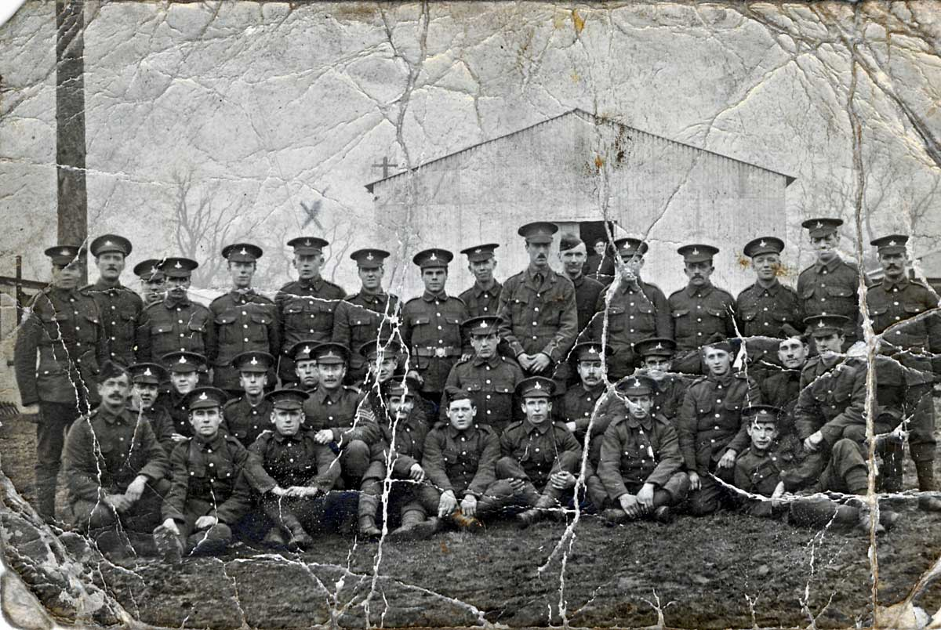
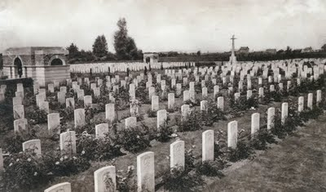
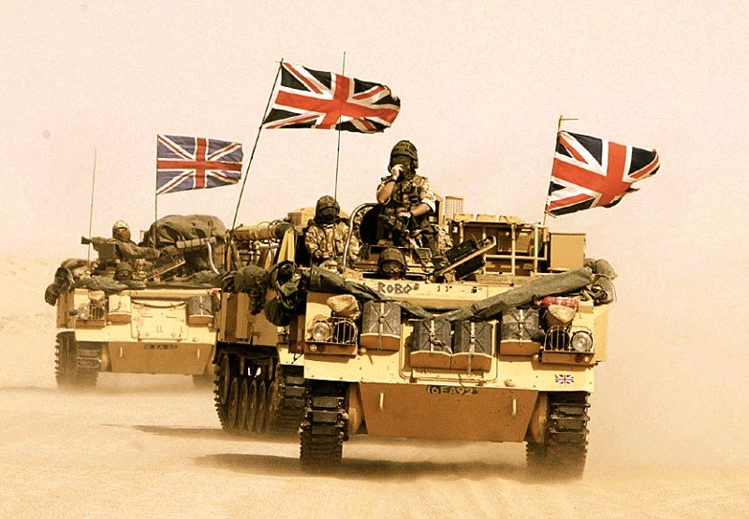
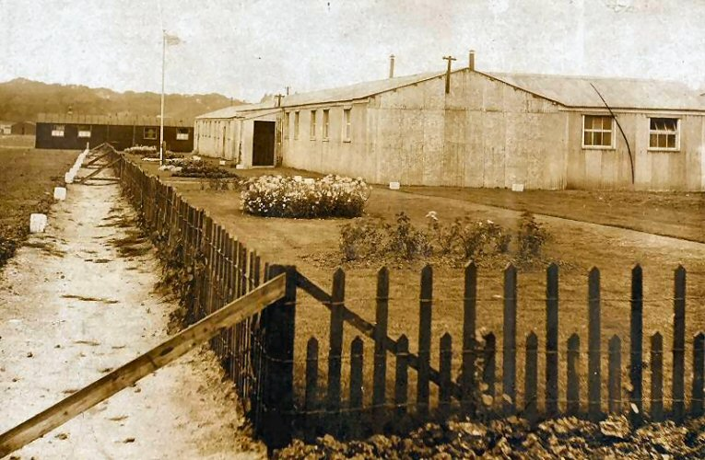

I will remember you
Will you remember me?
Don’t let your life pass you by
Weep not for the memories
I’m so tired but I can’t sleep
Standin’ on the edge of something
much too deep
It’s funny how we feel so much
But we can’t say a word
We are screaming inside,
But none of us are heard
But I will remember you
Will you remember me?
Don’t let your life pass you by
Weep not for the memories

Slide 7
I WILL REMEMBER YOU
I will remember you
Will you remember me?
Don’t let your life pass you by
Weep not for the memories
I’m so tired but I can’t sleep
Standin’ on the edge of something much too deep
It’s funny how we feel so much but we cannot say a word
We are screaming inside, but we can’t be heard
But I will remember you
Will you remember me?
Don’t let your life pass you by
Weep not for the memories
WHEN I’M KILLED
When I'm killed, don't think of me
Buried there in Cambrin Wood,
Nor as in Zion think of me
With the Intolerable Good.
And there's one thing that I know well,
I'm damned if I'll be damned to Hell!
So when I'm killed, don't wait for me,
Walking the dim corridor;
In Heaven or Hell, don't wait for me,
Or you must wait for evermore.
You'll find me buried, living-dead
In these verses that you've read.
So when I'm killed, don't mourn for me,
Shot, poor lad, so bold and young,
Killed and gone--don't mourn for me.
On your lips my life is hung:
O friends and lovers, you can save
Your playfellow from the grave.

Slide 8
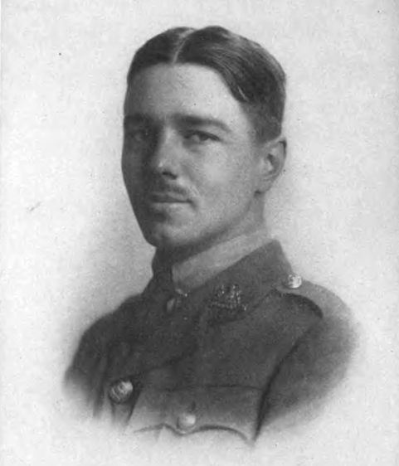
Wilfred Owen

Slide 9
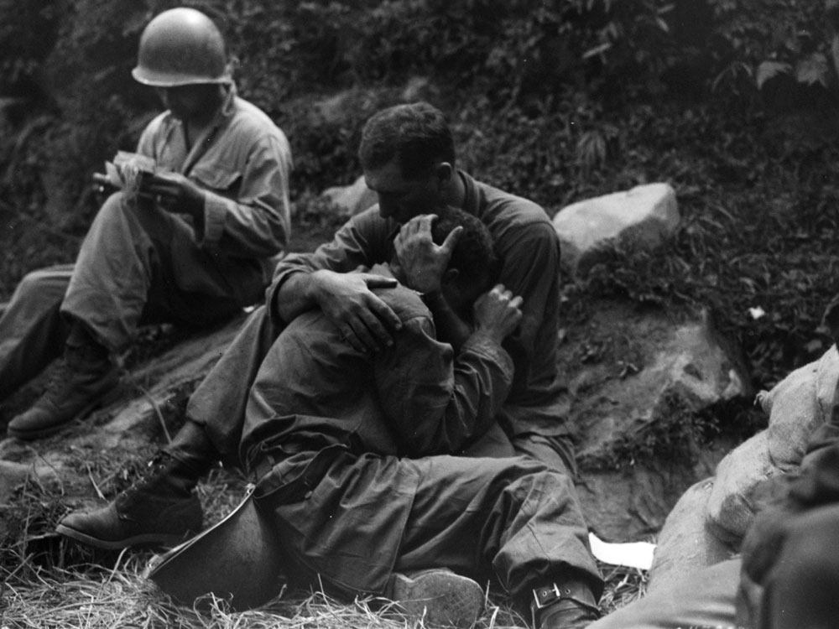
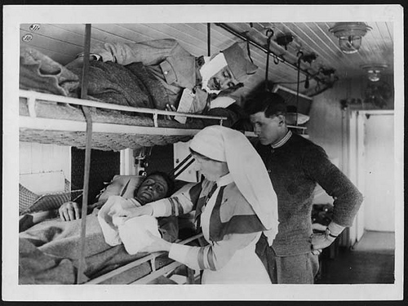
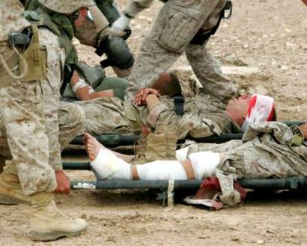
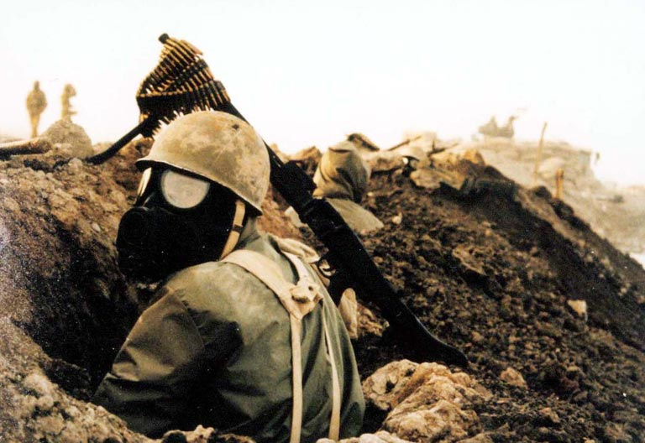
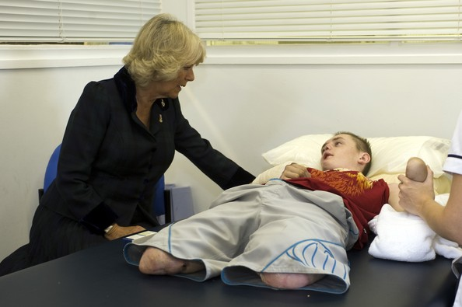
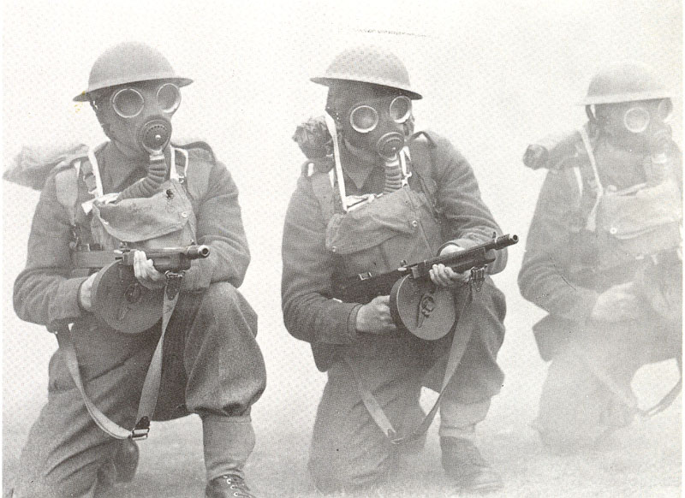

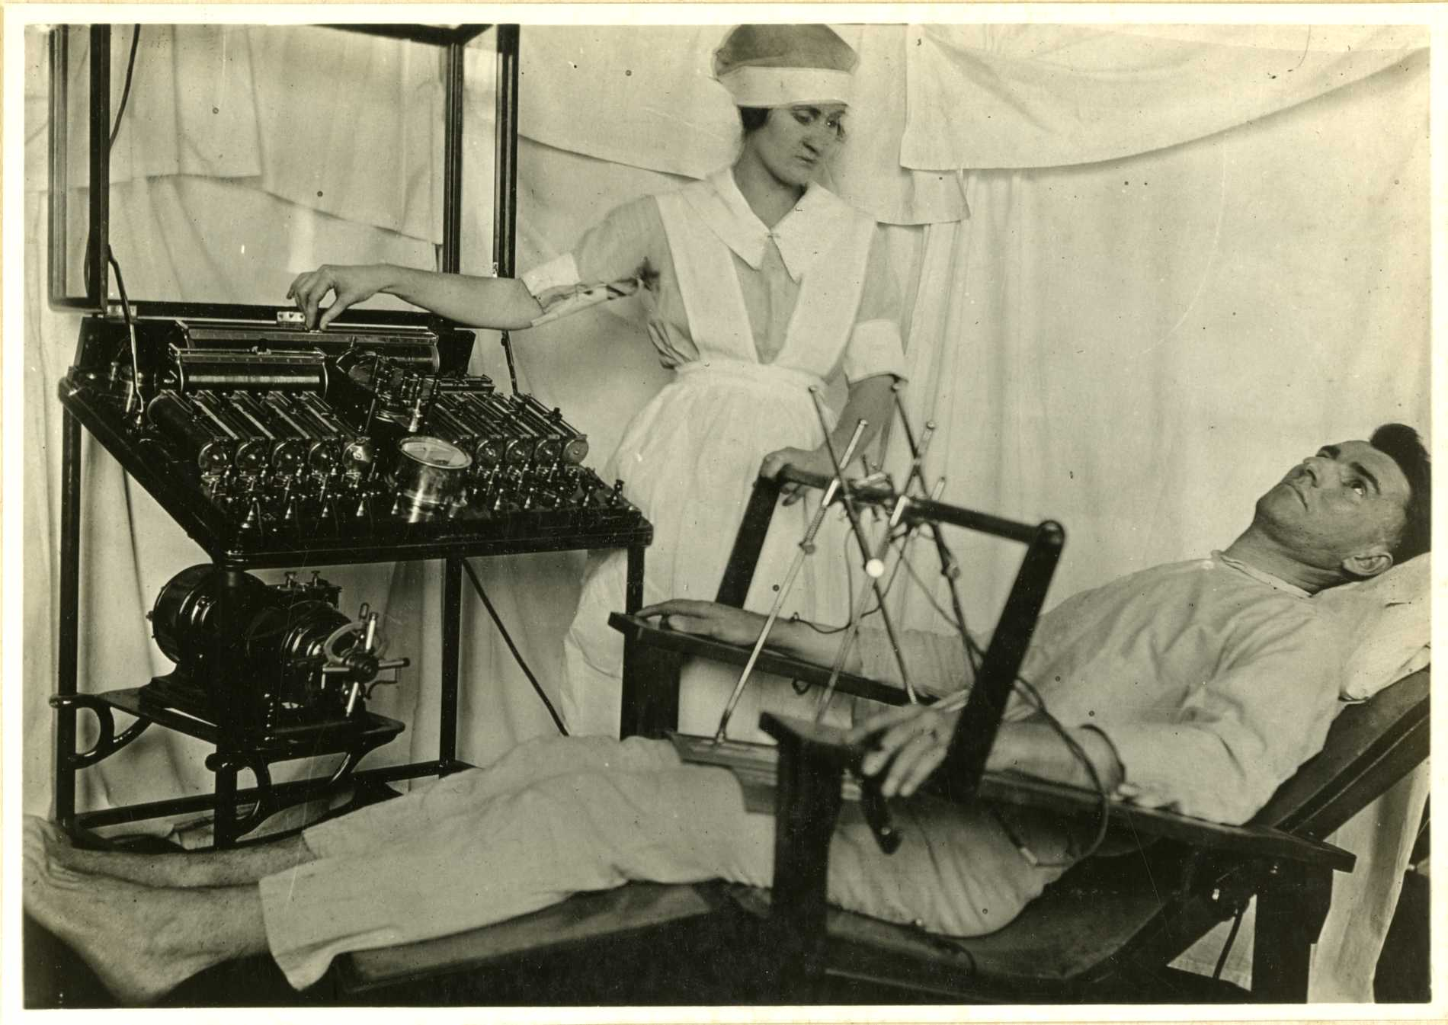
I can't remember anything
can't tell if this is true or dream
deep down inside I feel to scream
this terrible silence stops me
now that the war is through with me
I'm waking up, I cannot see
that there's not much left of me
nothing is real but pain now
hold my breath as I wish for death
oh please God, wake me
back in the womb it's much too real
in pumps life that I must feel
but can't look forward to reveal
look to the time when I'll live
fed through the tube that sticks in me
just like a wartime novelty
tied to machines that make me be
cut this life off from me

Slide 10
MENTAL CASES
Who are these? Why sit they here in twilight?
Wherefore rock they, purgatorial shadows,
Drooping tongues from jaws that slob their relish,
Baring teeth that leer like skulls' tongues wicked?
Stroke on stroke of pain, -- but what slow panic,
Gouged these chasms round their fretted sockets?
Ever from their hair and through their hand palms
Misery swelters. Surely we have perished
Sleeping, and walk hell; but who these hellish?
-- These are men whose minds the Dead have ravished.
Memory fingers in their hair of murders,
Multitudinous murders they once witnessed.
Wading sloughs of flesh these helpless wander,
Treading blood from lungs that had loved laughter.
Always they must see these things and hear them,
Batter of guns and shatter of flying muscles,
Carnage incomparable and human squander
Rucked too thick for these men's extrication.
Therefore still their eyeballs shrink tormented
Back into their brains, because on their sense
Sunlight seems a bloodsmear; night comes blood-black;
Dawn breaks open like a wound that bleeds afresh
-- Thus their heads wear this hilarious, hideous,
Awful falseness of set-smiling corpses.
-- Thus their hands are plucking at each other;
Picking at the rope-knouts of their scourging;
Snatching after us who smote them, brother,
Pawing us who dealt them war and madness.
ONE
I can't remember anything
can't tell if this is true or dream
deep down inside I feel to scream
this terrible silence stops me
now that the war is through with me
I'm waking up, I cannot see
that there's not much left of me
nothing is real but pain now
hold my breath as I wish for death
oh please God, wake me
back in the womb it's much too real
in pumps life that I must feel
but can't look forward to reveal
look to the time when I'll live
fed through the tube that sticks in me
just like a wartime novelty
tied to machines that make me be
cut this life off from me

