Slide 1
Group 12
Jamie Lam
Alondra Bains
Taryn Kirkwood

Slide 2
American Eagle
News Report
The South’s Leading News Source

Slide 3
BREAKING NEWS!
Escaped Slave!!

Slide 4
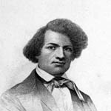
Police Artist Rendering

Slide 5


Slide 6


Slide 7


Slide 8


