Slide 1
WORLD WAR I
Poets & Artists
Mackenzie Hunt, Robert Mclaughlin, Tyler Ratcliff, Katherine Ruhm

Slide 2
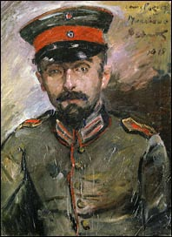
The Treasure
Rupert Brooke
When color goes home into the eyes,
And lights that shine are shut again,
With dancing girls and sweet birds' cries
Behind the gateways of the brain;
And that no-place which gave them birth, shall close
The rainbow and the rose: --
Still may Time hold some golden space
Where I'll unpack that scented store
Of song and flower and sky and face,
And count, and touch, and turn them o'er,
Musing upon them: as a mother, who
Has watched her children all the rich day through,
Sits, quiet-handed, in the fading light,
When children sleep, ere night.
Lovis Corinth, Bildnis Hermann Struck, 1915

Slide 3
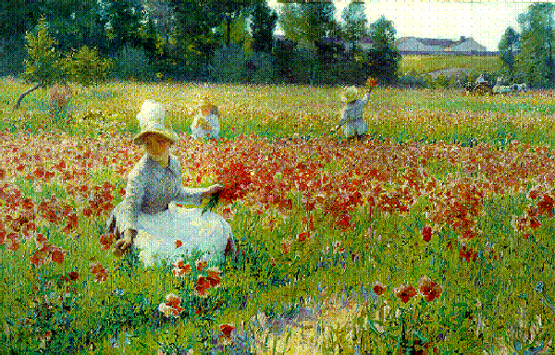
In Flanders Fields
John McCrae
Take up our quarrel with the foe:
To you from failing hands we throw
The torch; be yours to hold it high.
If ye break faith with us who die
We shall not sleep, though poppies grow
In Flanders fields.
We are the Dead. Short days ago
We lived, felt dawn, saw sunset glow,
Loved and were loved, and now we lie,
In Flanders fields.
In Flanders fields the poppies blow
Between the crosses, row on row,
That mark our place; and in the sky
The larks, still bravely singing, fly
Scarce heard amid the guns below.
Robert Vonnoh, In Flanders Field- Where Soldiers Sleep and Poppies Grow, 1890

Slide 4
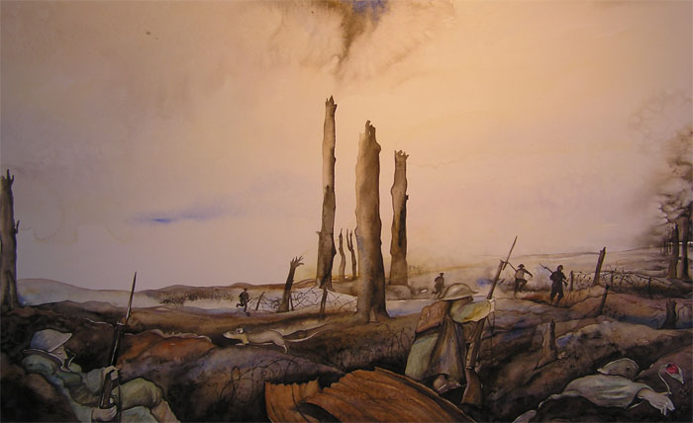
Photograph: National Army Museum
The darkness crumbles away
It is the same old druid Time as ever,
Only a live thing leaps my hand,
A queer sardonic rat,
As I pull the parapet’s poppy
To stick behind my ear.
Droll rat, they would shoot you if they knew
Your cosmopolitan sympathies,
Now you have touched this English hand
You will do the same to a German
Soon, no doubt, if it be your pleasure
To cross the sleeping green between.
It seems you inwardly grin as you pass
Strong eyes, fine limbs, haughty athletes,
Less chanced than you for life,
To cross the sleeping green between.
It seems you inwardly grin as you pass
Strong eyes, fine limbs, haughty athletes,
Less chanced than you for life,
Bonds to the whims of murder,
Sprawled in the bowels of the earth,
The torn fields of France.
What do you see in our ees
At the shrieking iron and flame
Hurled through still heavens?
What quaver- what heart aghast?
Poppies whose roots are in men’s veins
Drop, and are ever dropping;
But mine in my ear is safe,
Just a little white with the dust.
Break of Day in the Trenches
Isaac Rosenberg

Slide 5
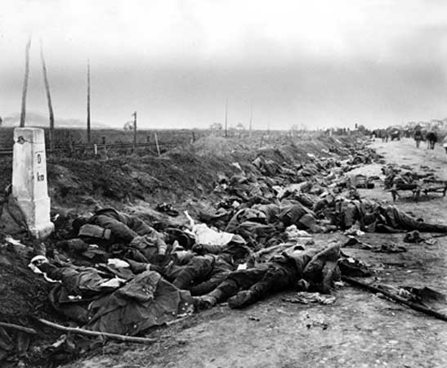
Photograph: Library of Congress, Washington D.C.
When You See Millions of the Mouthless Dead
Charles Sorley
Give them not praise. For deaf, how should they know
It is not curses heaped on each gashed head?
Nor tears. Their blind eyes see not your tears flow.
Nor honor. It is easy to be dead.
Say only this, “They are dead.” Then add thereto,
“Yet many a better one has died before.”
Then, scanning all the o’ercrowded mass, should you
Perceive one face that you loved heretofore,
It is a spook. None wears the face you knew.
Great death has made all his for evermore.
When you see millions of the mouthless dead
Across your dreams in pale battalions go,
Say not soft things are other men have said,
That you’ll remember. For you need not so.

Slide 6
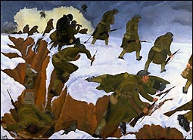
For All We Have and Are
Rudyard Kipling
John Nash, Over the Top
For all we have and are,
For all our children’s fat,
Stand up and meet the war.
The Hun is at the gate!
Our world has passed away
In wantonness o’erthrown.
There is nothing left to-day
But steel and fire and stone.
Though all we knew depart,
The old commandments stand:
“In courage keep your heart,
In strength lift up your hand.”
Once more we hear the word
That sickened earth of old:
“No law except the sword
Unsheathed and uncontrolled.”
Once more it knits mankind,
Once more the nations go
To meet and break and bind
A crazed and driven foe.
Comfort, content, delight–
The ages’ slow-bought gain–
They shrivelled in a night,
Only ourselves remain
To face the naked days
In silent fortitude,
Through perils and dismays
Renewed and re-renewed.
Though all we made depart,
The old commandments stand:
“In patience keep your heart,
In strength lift up your hand.”
No easy hopes or lies
Shall bring us to our goal,
But iron sacrifice
Of body, will and soul.
There is but one task for all—
For each one life to give.
Who stands if freedom fall?
Who dies if England live?

Slide 7
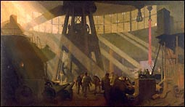
Trafalgar Square
Robert Bridges
Fool that I was! my heart was sore,
Yea, sick for the myriad wounded men,
The maim’d in the war: I had grief for each one:
And I came in the gay September sun
To the open smile of Trafalgar Square,
Where many a lad with a limb foredone
Loll’d by the lion-guarded column
That holdeth Nelson statued thereon
Upright in the air.
The Paliament towers, and the Abbey towers,
The white Horseguards and the gray Whitehall,
He looketh on all,
Past Somerset House and the river’s bend,
To the pillar’d dome of St. Paul,
That slumbers, confessing God’s solemn
On Britain’s glory, to keep it ours—
While children true her prowess renew
And throng from the ends of the earth to defend
Freedom and honour– til Earth shall end.
The gentle unjealous Shakespeare, I trow,
In his country grave of peaceful fame
Must feel exiled from life and flow,
If he thinks of this man with his warrior claim,
Who looketh on London as if’t were his own,
As he standeth in stone, aloft and alone,
Sailing the sky, with one arm and one eye.
George Clausen, In the Gun Foundry at Woolwich Aresenal

Slide 8
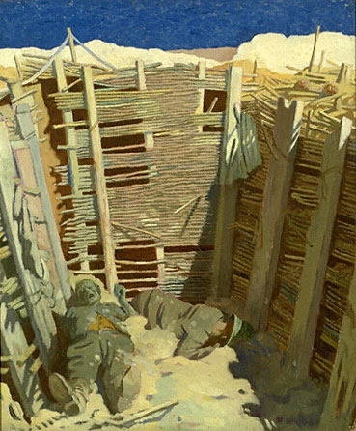
Anthem of a Doomed Youth
Wilfred Owen
What passing-bells for these who die as cattle?
Only the monstrous anger of the guns.
Only the stuttering rifles’ rapid rattle
Can patter out their hasty orisons.
No mockeries now for them; no prayers nor bells;
Nor any voice of mourning save the choirs, --
The shrill, demented choirs of wailing shells;
And bugles calling for them from sad shires.
What candles may be held to speed them all?
Not in the hands of boys but in their eyes
Shall shine the holy glimmers of goodbyes.
The pallor of girls’ brows shall be their pall;
Their flowers the tenderness of patient minds,
And each slow dusk a drawing-down of blinds.
William Opren, Germans in Trench

Slide 9
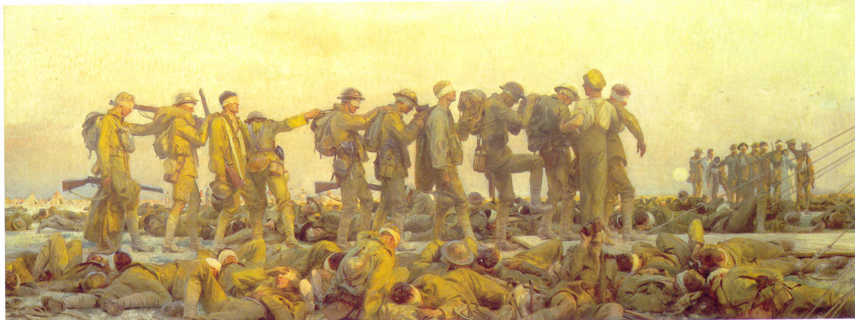
They
Siegfried Sassoon
The Bishop tells us: ‘When the boys come back
‘They will not be the same; for they’ll have fought
‘In a just cause: they lead the last attack
‘On Anti-Chris; their comrades’ blood has bought
‘New right to breed an honourable race,
‘They challenged Death and dared him face to face.’
‘We’re none of us the same!’ the boys reply.
‘For George lost both his legs; and Bill’s stone blind;
‘Poor Jim’s shot through the lungs and like to die;
‘And Bert’s gone syphilitic; you’ll not find
‘A chap who’s served that hasn’t found some change.
‘And the Bishop said: ‘The ways of God are strange!’

