Slide 1
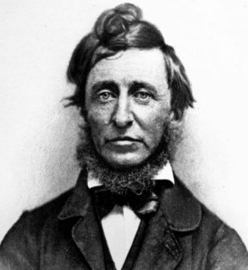
Would Thoreau’s Project Work Today?
By: Evan, Evan, Ben, and Jordan

Slide 2
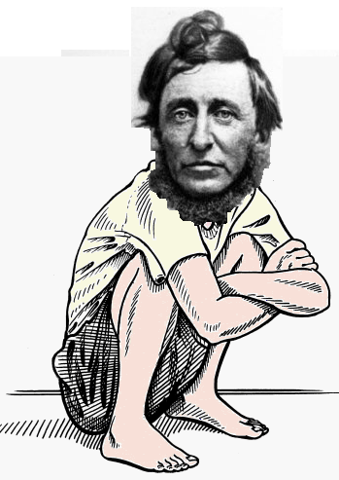
Squatting
Thoreau did not own the land he built his house on
Instead, he was squatting – using an unoccupied space that he didn’t have permission to use.
He squatted for over 2 years
on the same plot

Slide 3

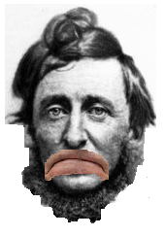
Could he still do that?
The short answer – probably not
Deed-holders can easily evict squatters on the grounds of loitering and/or trespassing
Neighbors often call the police on squatters

Slide 4
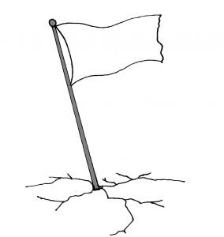

Could he still do that?
Squatter’s rights – he could claim the land for his own if he could stay there for several years without being evicted
However, many states require paying property tax in order to claim land by squatter’s rights

Slide 5

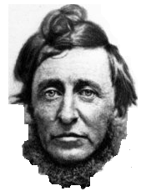
Could he still do that?
Homesteading – basically claiming government land by squatter’s rights
No longer exists – Congress got rid of it in 1976
Bring Back Homesteading

Slide 6
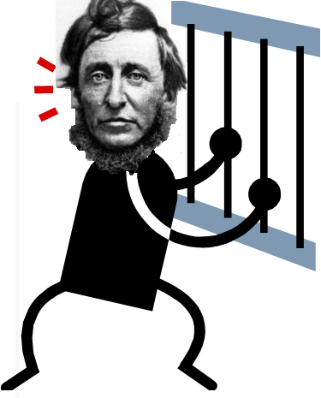
Trouble on the horizon
TRESPASSING: According to Massachusetts General Law, a charge of trespassing has the following penalties:
up to 30 days in jail
or, a fine of up to $100,
or, both the fine and jail term.
CUTTING DOWN TREES: Injury to trees of another person. Provides for "imprisonment for not more than six months or... a fine of not more than five hundred dollars.“
POACHING : Class C misdemeanor so it can be up to 3 months in jail or up to a $500 fine. The actual penalty is up to the Judge

Slide 7

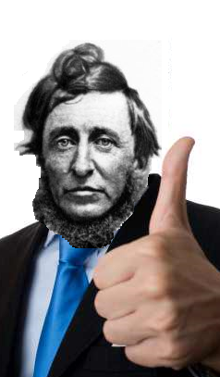
Thoreau’s Groceries: 1845
Rice: $1.73½
Molasses: 1.73
Rye Meal: 1.04 ¾
Indian Meal: .99 ¾
Pork: .22
Flour: .88
Sugar: .80
Lard: .65
Apples: .25
Dried Apple: .22
Sweet Potatoes: .10
One Pumpkin: .06
One Watermelon: .02
Salt: .03
Total: $8.74

Slide 8

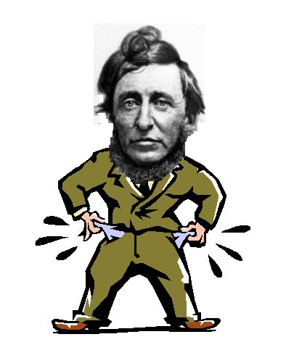
Food Allowance through Inflation: 2011
Rice: 40.12
Molasses: 40.00
Rye Meal: 24.22
Indian Meal: 23.06
Pork: 5.09
Flour: 20.35
Sugar: 18.50
Lard: 15.03
Apples: 5.78
Dried Apple: 5.09
Sweet Potatoes: 2.31
One Pumpkin: 1.39
One Watermelon: .46
Salt: .69
Total: $202.08

Slide 9
Overall Expenses: 1845
House: 28.12 ½
Farm One Year: 14.72 ½
Food: 8.74
Clothing etc.: 8.40 ¾
Oil etc.: 2.00
TOTAL: $61.99 ¾

Slide 10
Total Expense Allowance: 2011
House: 650.29
Farm One Year: 340.47
Food: 202.08
Clothing etc.: 194.39
Oil etc.: 46.24
TOTAL:$1433.48

Slide 11
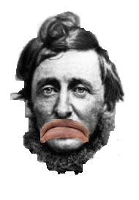
Conclusion
In the world of today, Thoreau’s project would not work.
In fact, based on Thoreau’s actions he would be in trouble with the law.
Thoreau would most likely end up in prison.
However, he would still write…

Slide 12
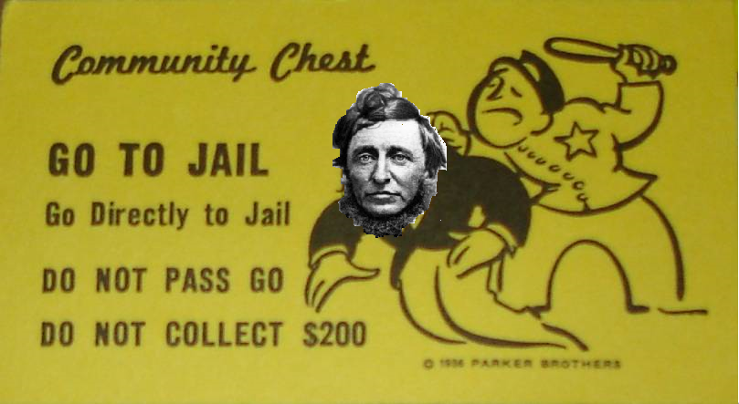
Thoreau’s Prison Haiku
Got thrown in Prison
For numerous offenses
Life could not be worse.

