Slide 1

Henry David Thoreau
Walden; or, Life in the Woods
Notes:
http://www.youtube.com/watch?v=Hr6Te_pVscU

Slide 2

Thoreau’s Purpose
  "I went to the woods because I wished to live deliberately, to front only the essential facts of life, and see if I could not learn what it had to teach, and not, when I came to die, discover that I had not lived…to get the whole and genuine meanness of it, and publish its meanness to the world; or if it were sublime, to know it by experience, and be able to give a true account of it in my next excursion."

Slide 3


Slide 4

  His Journey
  Went on a two year journey into the woods away from civilization
  Observed, farmed, surveyed, and wrote in his journal
  He wanted to have an experiment in living, he saw the flaws of society and sought an escape

Slide 5


Slide 6

  What did he learn?
  In nature the rich and poor are equal
  People take what they have for granted
  He learned to value simplicity
  The importance of self reliance

Slide 7


Slide 8
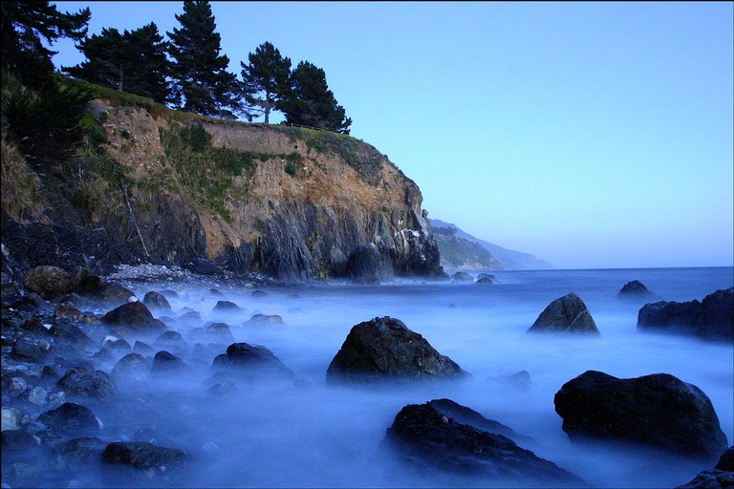

Slide 9

  “Not until we are lost do we begin to understand ourselves”
Notes:
Thoreau saw society as flawed and that is why he decided to isolate himself. We see that the biggest flaw with society today is our dependence on technology, so we decided to conduct our own experiment

Slide 10
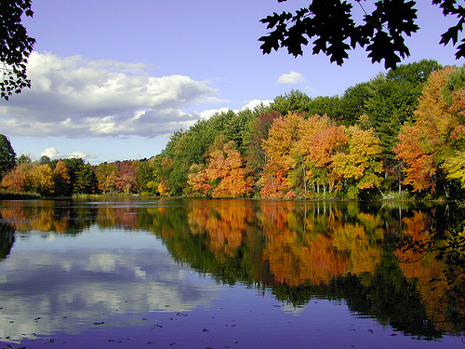

Slide 11

Our Experiment

Slide 12


Slide 13
Food for Thought…
“How vain is it to sit down to write when you have not stood up to live”

