Slide 1

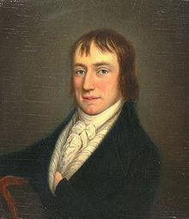
William Wordsworth
Poems

Slide 2

I wandered lonely as a cloud

Slide 3
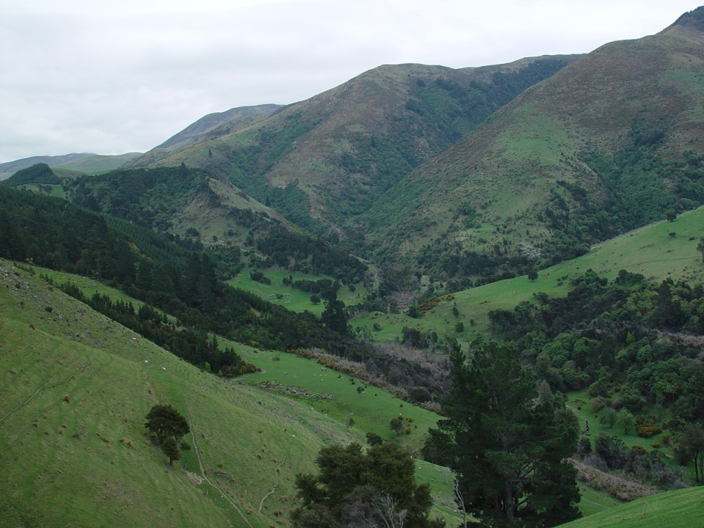
That floats on high o'er vales and hills,

Slide 4
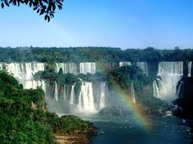
When all at once I saw a crowd,

Slide 5

A host, of golden daffodils

Slide 6
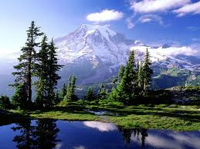
Beside the lake, beneath the trees,

Slide 7
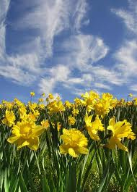
Fluttering and dancing in the breeze.

Slide 8
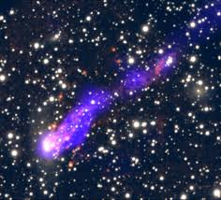
Continuous as the stars that shine

Slide 9

And twinkle on the milky way,

Slide 10

They stretched in never-ending line

Slide 11
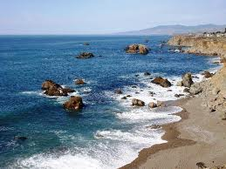
Along the margin of a bay:

Slide 12
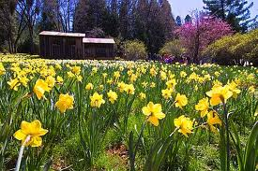
Ten thousand saw I at a glance,

Slide 13

Tossing their heads in sprightly dance.

Slide 14
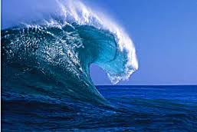
The waves beside them danced; but they
Out-did the sparkling waves in glee:

Slide 15
A poet could not but be gay,

Slide 16

In such a jocund company:

Slide 17
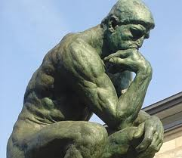
I gazed—and gazed—but little thought

Slide 18

What wealth the show to me had brought:

Slide 19

For oft, when on my couch I lie
In vacant or in pensive mood,

Slide 20

They flash upon that inward eye
Which is the bliss of solitude;

Slide 21

And then my heart with pleasure fills,

Slide 22

And dances with the daffodils.

Slide 23


